Slide 1


2026 Q1
Gaming Monitor Product Roadmap
www.promptcontrol.com

Slide 2

Greeting from the CEO
Dear valuable customers,
Most of all, let me express my sincere gratitude for concern and care to us.
The innovative digital technology in Gaming monitors and Industrial display brought us enormous challenges since PromptControl Technology Co., Ltd. was established in 2015. We have won threats and competitions like surging waves which hardened our passion toward to be a leader of gaming monitors and industrial display. The outstanding quality and per­formance surpassing customer's expectation allowed us to hold unbeatable strength in gaming monitors when we kicked off into manufacturing of gaming monitors. The endless efforts on technology enhancement have been invested to lead the market with resolution to serve customer's need by the “Excellent & Costive Technology" product. As the turnaround time for industrial display comes to be shorter, our job skill with agility and flexibility enables us to satisfy customer's needs with short lead time and diverse specifications. In addition, full line up in terms of all monitor size and firm manage­ment of software on own A/D board won't disappoint any customers looking for state of the art display solutions.
Yours sincerely,
Frank ZHANG
Managing Director
PromptControl Technology Co., Ltd.

Slide 3

Why We Are Different
PromptControl Technology Co., Ltd. is a leading global provider of touch solutions, including touch screens, touch displays, touch all-in-one machines, and customized touch products. We have been committed to providing customers with advanced, efficient, and cost-effective touch solutions. We have won the support and love of a large number of customers worldwide.
10
+
60
4000m²
+
+
Years
Staff
Factory
10 Years+ manufacturer focus with Touchscreen & Touch monitor
>60 company staff with
>15 people focus with R&D
>60 company staff with
>15 people focus with R&D
1Million
40
5000
+
+
+
Installation
Countries
Capacity
One Million+ Installations worldwide
40+ Countries Exported worldwide
Multi-touch monitors:5K/month
All-in-one computers:2K/month
ODM/OEM services

Slide 4

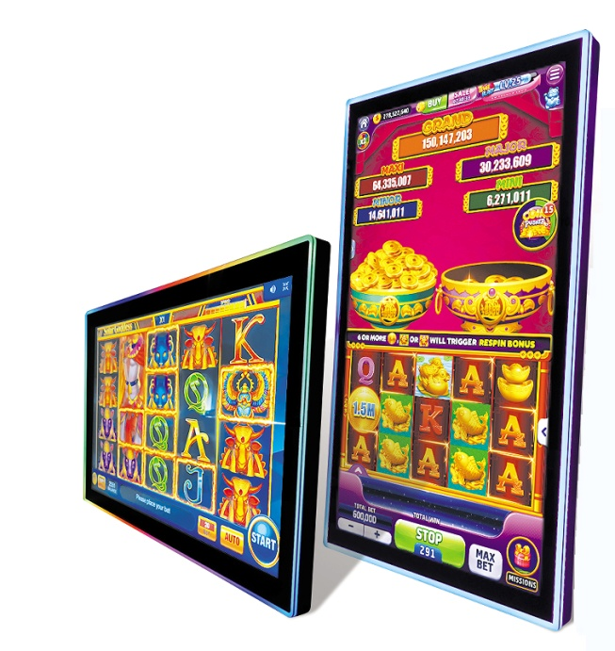
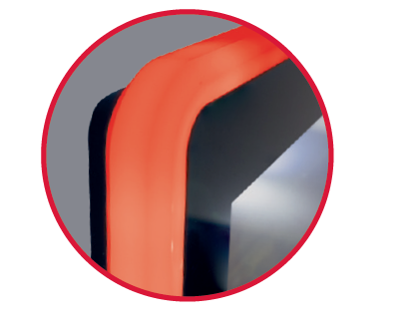

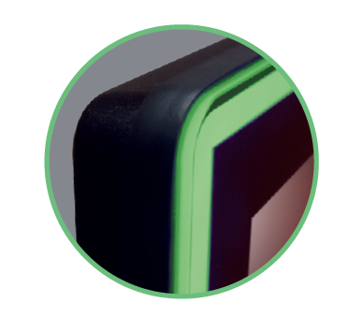
Halo Design
Halo
Edge
Front
SIZE | Touch | FEATURES | LED DESIGN | EP | FEP | PP
21.5" | PCAP & non-Touch | 1920x1080, 250nits | Front、Edge、Side |  |  | √
23.8’’ | PCAP & non-Touch | 1920x1080, 250nits | Front、Edge、Side、Halo |  |  | √
24’’ | PCAP & non-Touch | 1920x360, 300nits | Edge |  | √
27" | PCAP & non-Touch | 1920x1080, 300nits | Front、Edge、Side |  |  | √
27’’ | PCAP & non-Touch | 1920x1080, 300nits | Halo |  | √
32’’ | PCAP & non-Touch | 1920x1080 or 3840x2160, 300nits | Edge |  |  | √
43’’ | PCAP & non-Touch | 3840x2160, 300nits | Edge |  | √

Slide 5
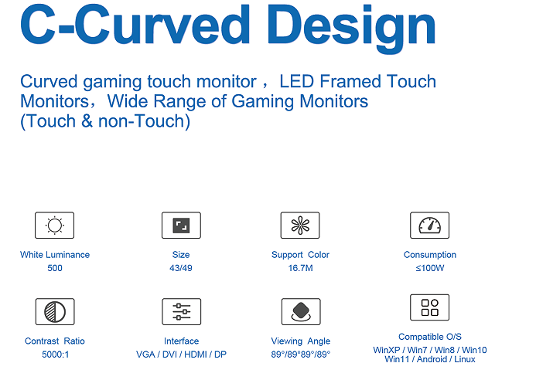
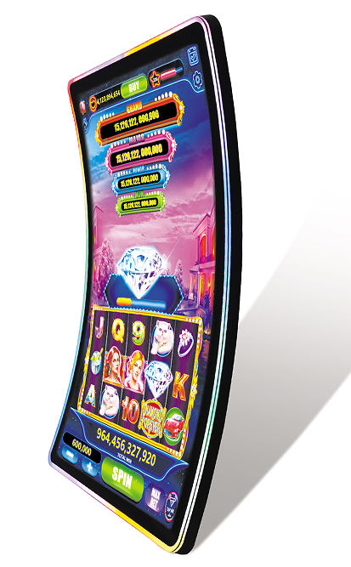
SIZE | Touch | FEATURES | LED DESIGN | EP | FEP | PP
32" | PCAP (R-1500) | 1920x1080 or 3840x2160, 350nits | Edge |  | √
43’’ | PCAP (R-1500) | 3840x2160, 400nits | Edge |  | √
49" | PCAP (R-1500) | 3840x2160, 400nits | Edge | √
55" | PCAP (R-1500) | 3840x2160, 400nits | Edge |  | √

Slide 6
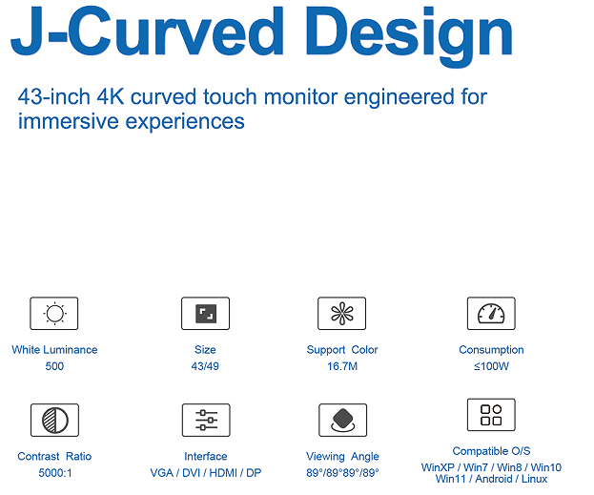
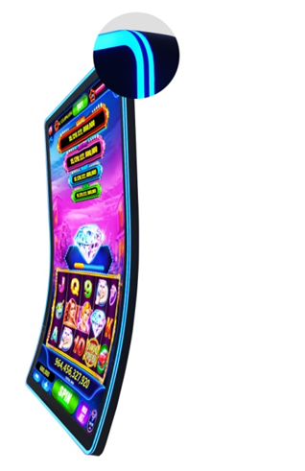
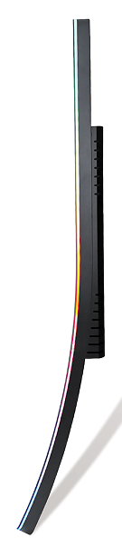
SIZE | Touch | FEATURES | LED DESIGN | EP | FEP | PP
43’’ | PCAP (R-1500) | 3840x2160, 400nits | Edge |  |  | √
49" | PCAP (R-1500) | 3840x2160, 400nits | Edge | √
55" | PCAP (R-1500) | 3840x2160, 400nits | Edge |  | √

Slide 7
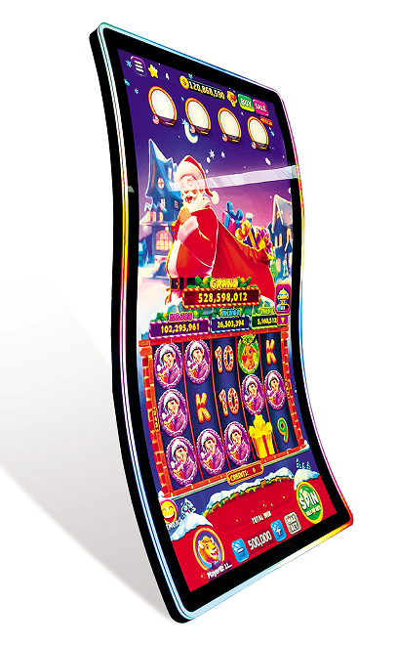
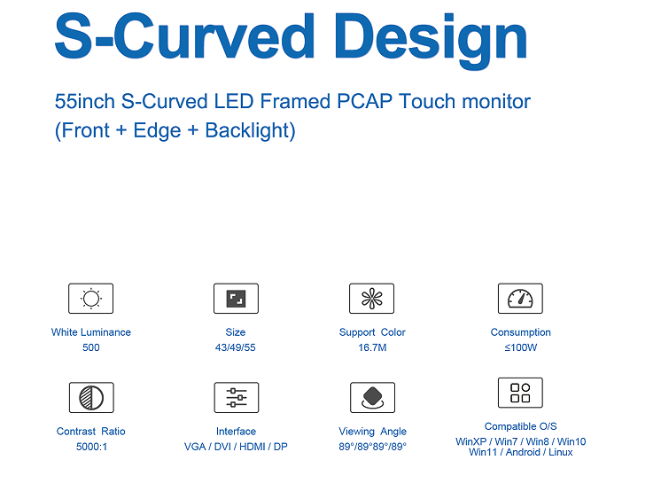
SIZE | Touch | FEATURES | LED DESIGN | EP | FEP | PP
55" | PCAP (R-1200&R1000) | 3840x2160, 400nits | Edge |  | √

Slide 8

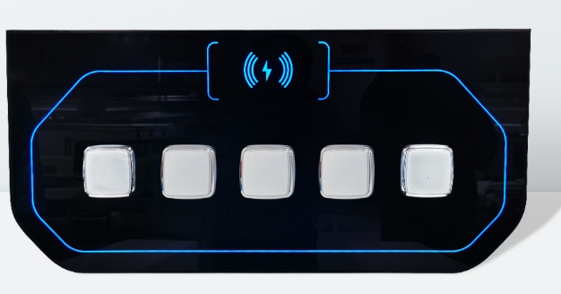

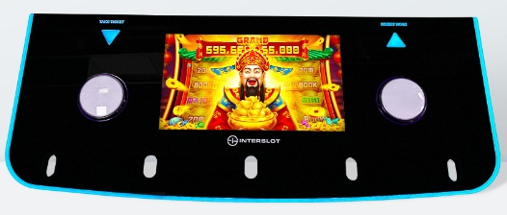
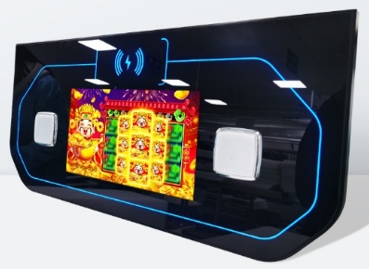
SIZE | Touch | FEATURES | LED LIGHTING | EP | FEP | PP
12.4" | PCAP | 1024x273, 400nits | Front |  | √
13.3" | PCAP | 1920x1080, 300nits | Front +Edge |  |  | √
13.3’’ | Non-Touch | N/A | Front |  | √

Slide 9
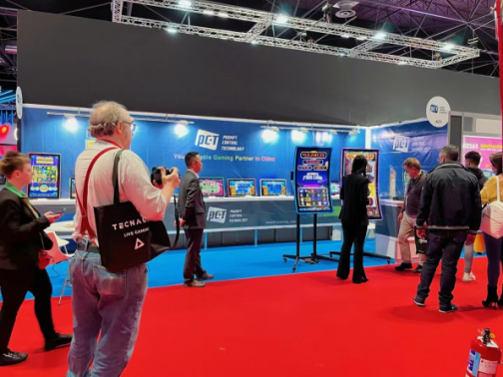
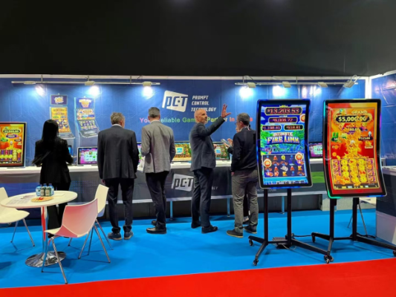
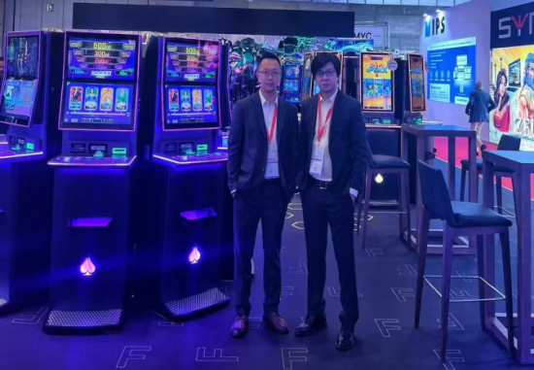
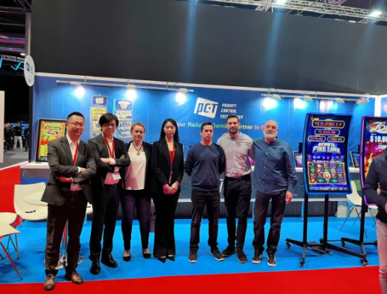
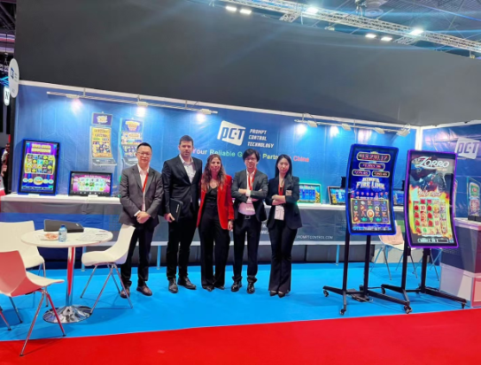
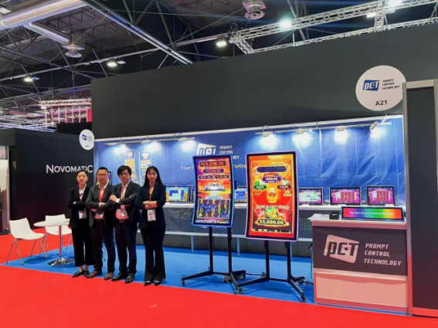
FJIMA 2024, Madrid, Spain
Button Decks

Slide 10
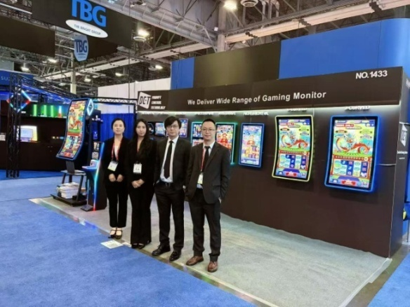

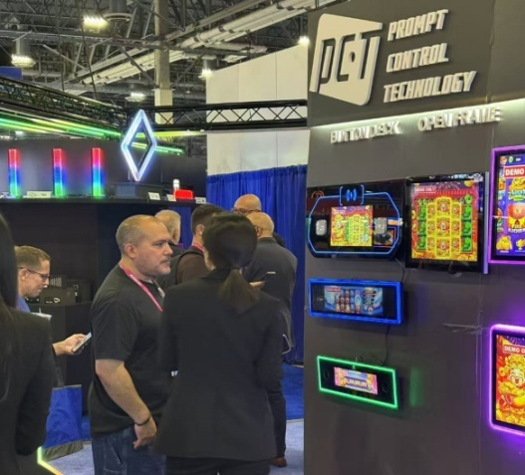
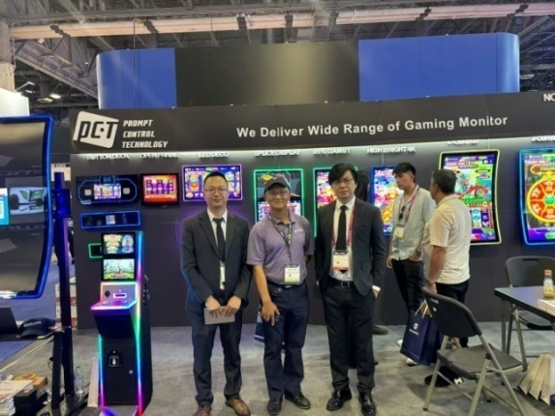
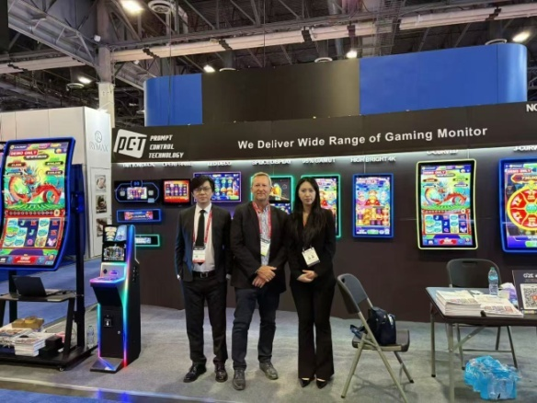
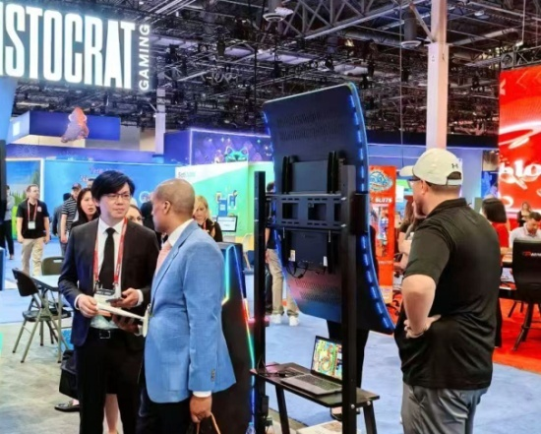
G2E, 2025, Las Vegas, USA
Button Decks

Slide 11
